Slide 1

College Event Management System
Submitted By:
Shani Kumar Gupta
(171500308)
Prince Singh
(171500239)
Notes:
Photo by Sean Pollock on Unsplash

Slide 2

Outline
INTRODUCTION
Main Idea
Major application area
TECHNOLOGIES USED IN THIS PROJECT
BASIC WEBSITE FUNCTIONALITY
Home Page
Admin Panel
Login Section
Admin Panel
Club Mentor Panel
Student Panel
CONCLUSION

Slide 3
Introduction
Main Idea Behind the Project:
In real scenarios, various events are taking place simultaneously inside an organization and everything got meshed up if venue is not available at desired time, also all hard work will become unproductive and leaves bad reputation of organization. So, we work with an event management system that is management website where all venues which are available at current time will be apportioned to user.

Slide 4

Major Application Area :
Educational Institute
Universities
Company

Slide 5
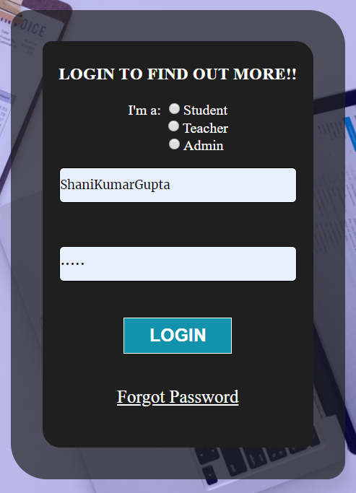
Technologies used in this Project:
HTML and CSS: HTML and CSS are used to create the website which is used to structure the website
JavaScript: It is used to provide the interactive web page so that everyone can interact with the website
PHP: It is used to control the backend activity like Post and Get the data and maintain the details

Slide 6
Basic Website functionality
1) Home Page:
- Home page consists of Navigation bar and Login section

Slide 7
Basic Website functionality
2) Login Section:
- Through sign in page Student, club mentor and Admin
In this page we provide Forget Password facilities to the Users also

Slide 8
Basic Website functionality
Admin can login to the home page
Admin can Approve and Reject the event venue request
Admin can edit or update and delete the user as well
Admin contact information will be there
Navigation bar will be there
3) Admin Panel:
Notes:
Photo by Sean Pollock on Unsplash

Slide 9
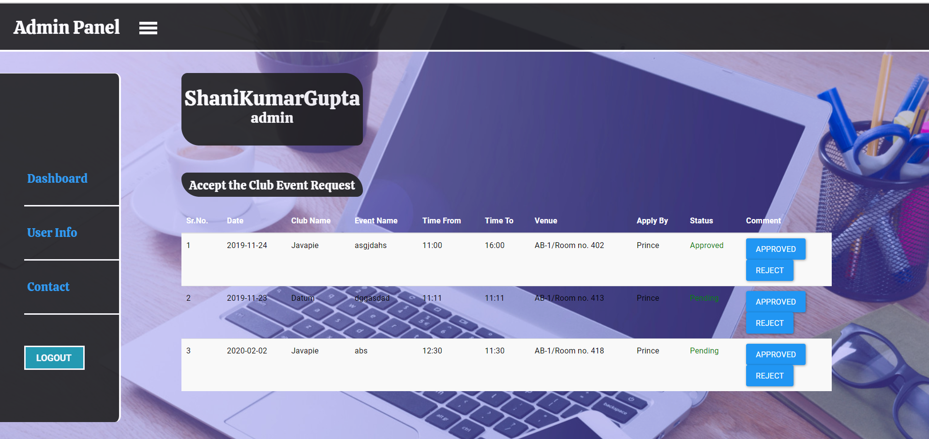
Basic Website functionality
Admin Panel:
Notes:
Photo by Sean Pollock on Unsplash

Slide 10
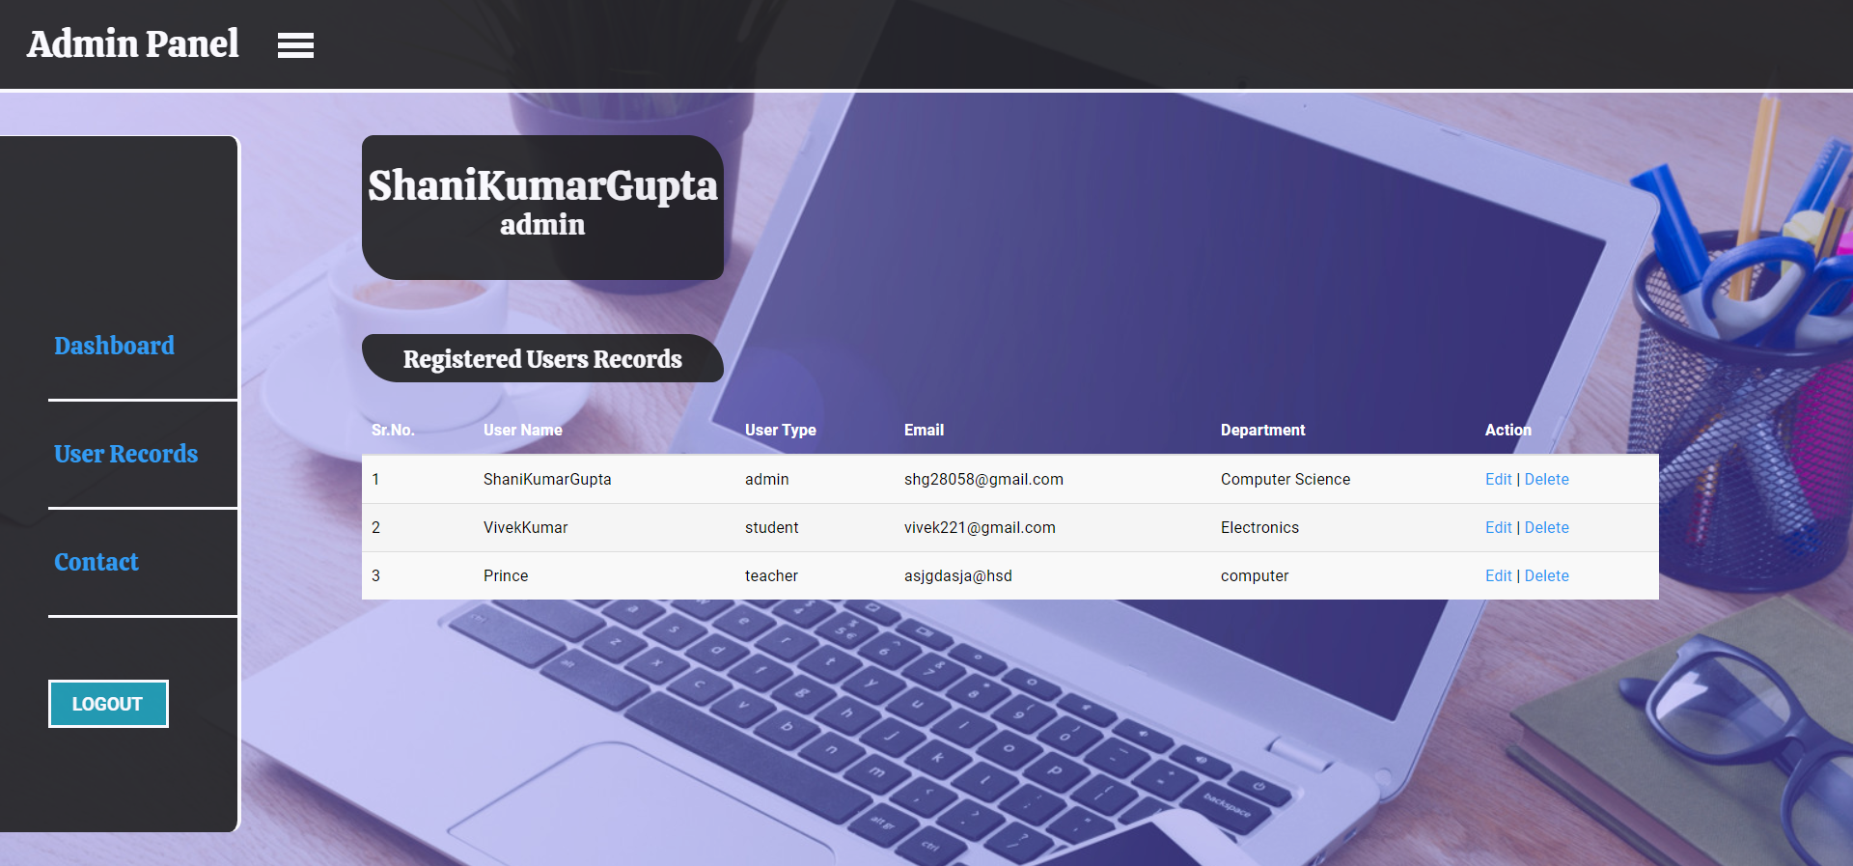
Basic Website functionality
Admin Panel with Edit and Delete User panel:
Notes:
Photo by Sean Pollock on Unsplash

Slide 11
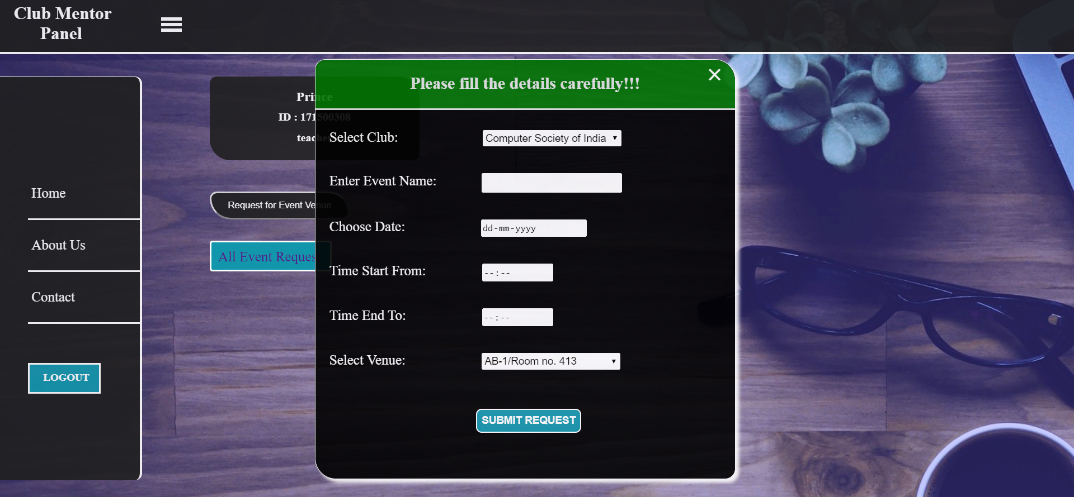
Club mentor can login through website
Club mentor can request for event venue
Club mentor can see the logs of event request
Basic Website functionality
4) Club Mentor Panel:

Slide 12
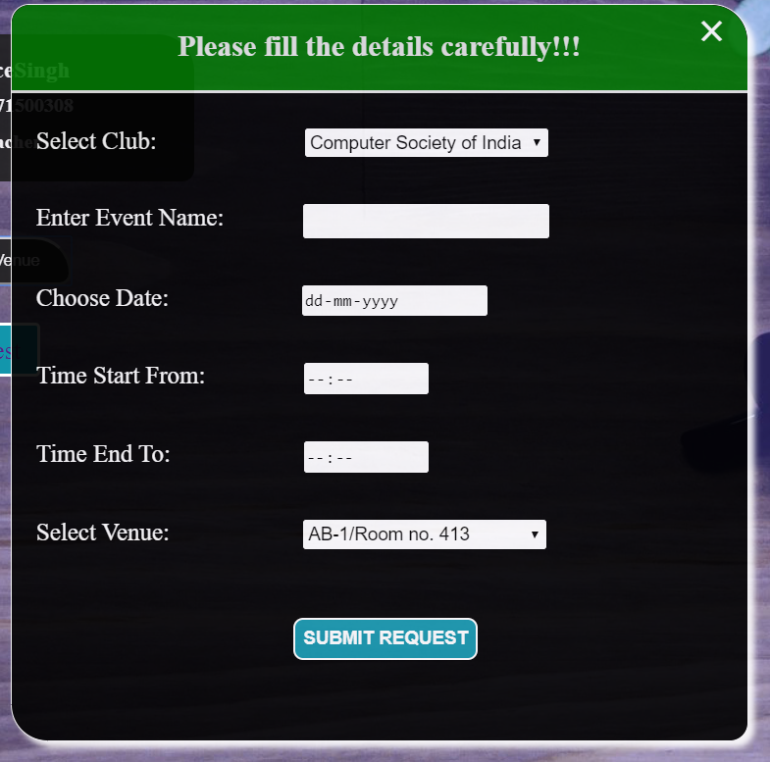
Basic Website functionality
Club Mentor Event Request:
Event request form so that club mentor can request for the event venue

Slide 13
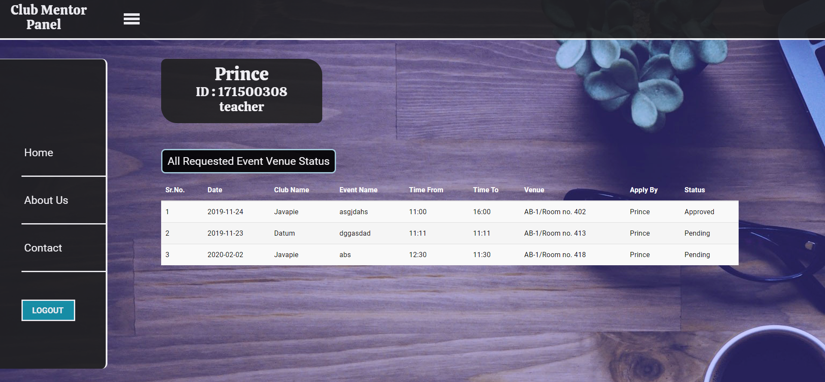
Basic Website functionality
Club Mentor Event Request Log:
Event request form so that club mentor can request for the event venue as well they can also see the logs of the events

Slide 14
Basic Website functionality
5) Student Panel:
Student can easily login through home page
Student can see the event and also apply for the same event
Notes:
Photo by Sean Pollock on Unsplash

Slide 15
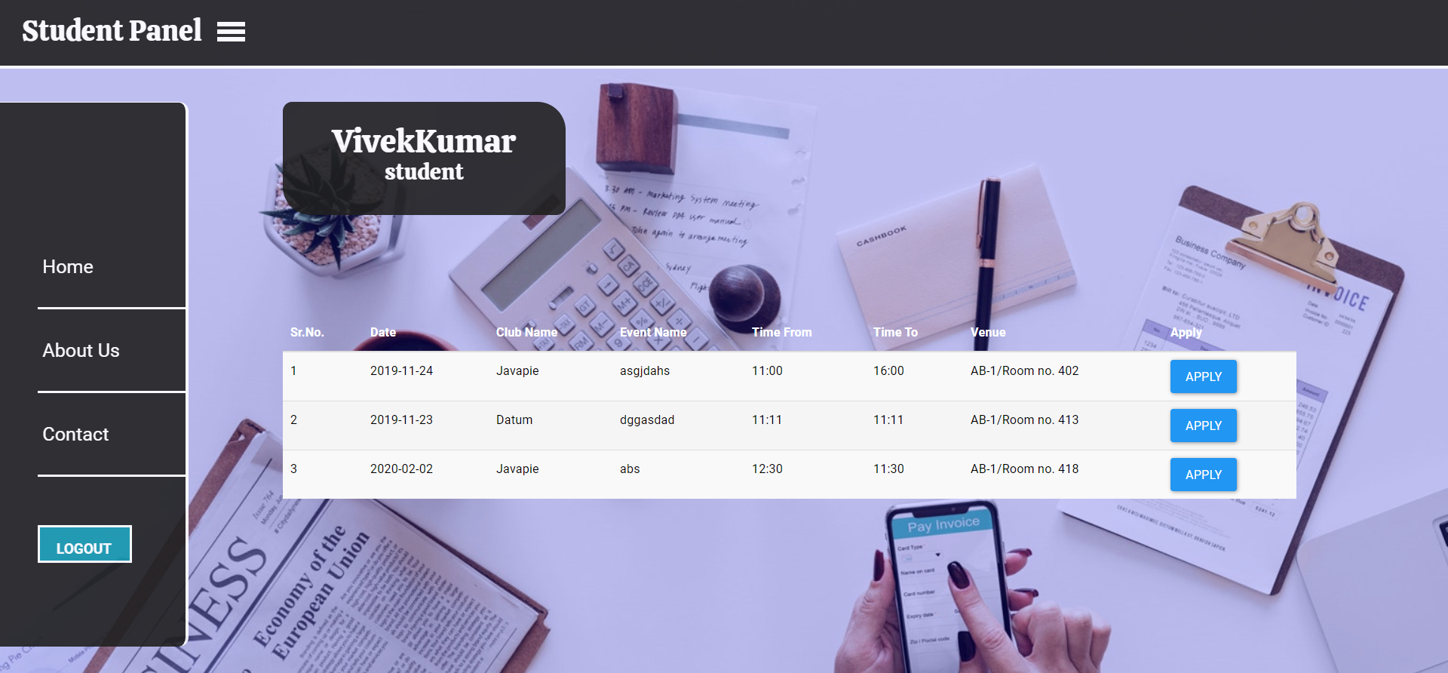
Basic Website functionality
Student Panel:
Notes:
Photo by Sean Pollock on Unsplash

Slide 16
Conclusion
College Event Management System website provide the different type of functionality to the user to handle the event
Login Section will be there
Admin, Club mentor as well as Student can login
Admin can approve the request as well as edit and delete the users
Club mentor can send the request to the admin for event venue
Club mentor can see the previous request log
Student can apply for the event through student panel

Slide 17
Thank You

